Slide 1
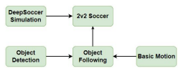
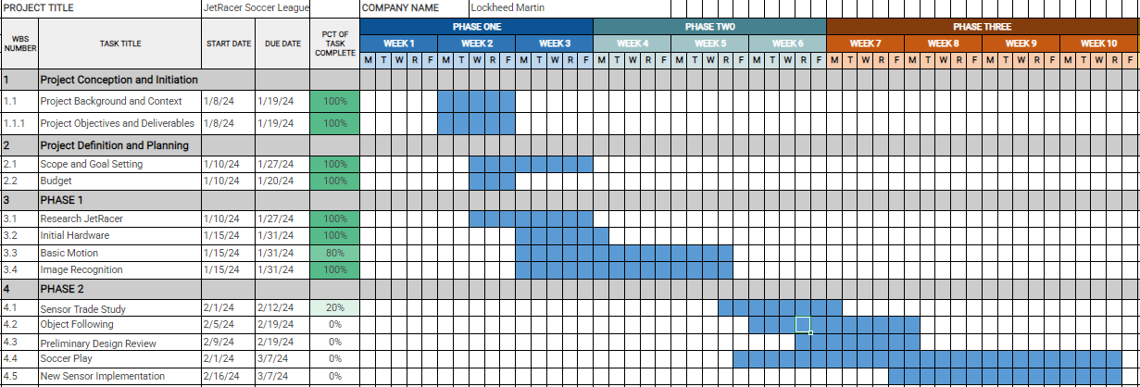
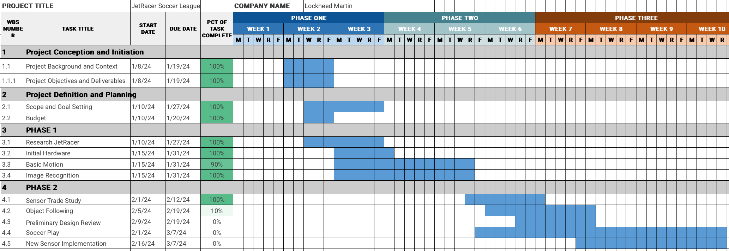
Overview
JetRacer Soccer Jarod Marshel, Casey Rittenhouse, Arjun Simha, Mason Kang, K Gupta, Julie Ham, Cooper Ritter
Overall Concept:
Overall Project Deliverable | Progress
Basic Movement | Done
Image recognition | Done
New sensor implementation | In progress
Object following/Ball Striking | In progress
Co-op and Versus | Not started
Github with documentation | In progress
Summary and report | Not started
New Sensor
Project is On Schedule
Gantt Chart/Schedule

Slide 2
Short-Term
JetRacer Soccer Jarod Marshel, Casey Rittenhouse, Arjun Simha, Mason Kang, K Gupta, Julie Ham, Cooper Ritter
Previous Meeting Action Items:
Item | Description | Owner | Target Date | Status
1 | Car CAD Models | Cooper | Feb 12 | Done
2 | Unity soccer simulation training | Mason | Jan 31 | Done
3 | Get all cars working with basic movement | Everyone | Feb 9 | In progress
4 | Redo hardware attachment to cars | Everyone | Feb 12 | Done
5 | Demonstrate image processing | Everyone | Jan 31 | Done
6 | Integrate ROS onto cars | Everyone | Feb 12 | In progress
7
Biweekly Action Items:
Item | Description | Owner | Target Date | Status
1 | System integration | Everyone | Feb 29 | Not started
2 | Preliminary Design Review | Everyone | Feb 19 | Not started
3 | Object following | Everyone | Feb 12 | In progress
4 | Build field for cars | Jarod | Feb 19 | Done
5 | Implement new sensor onto car | Everyone | Feb 12 | In progress
Significant Roadblocks/ Non-developing Items:
Budget:
New sensor on car (Zed 2) needs to be ordered and shipped to us
Total Proposed | Plan to Date | Used to Date | Used Vs Plan
$3500 USD | $0 USD | $0 USD | +/-$0 USD
Short Term Schedule:
Request for teaching staff:
Feb |  |  |  |  |  |  |  |  |  | Feb
5 |  |  |  |  | 12 |  |  | 15 |  | 19
Work on trade-study for new sensor
Finish field construction

Slide 3
Team Progress

Slide 4
ROS (Casey and Cooper)
JetRacer Soccer Jarod Marshel, Casey Rittenhouse, Arjun Simha, Mason Kang, K Gupta, Julie Ham, Cooper Ritter
Previous Work:
Fixed throttle stalling
Calibrated steering/throttle gains and offsets
Printed field brackets
Servo mount CAD for ZED2/servo
Created trade study for sensor choice
Future Work:
Continue Ubuntu 20.04 update and ROS Noetic install if Zed 2 is selected
Modify CV to publish results to ROS topic

Slide 5
LiDAR (Arjun and Jarod)
JetRacer Soccer Jarod Marshel, Casey Rittenhouse, Arjun Simha, Mason Kang, K Gupta, Julie Ham, Cooper Ritter
Previous Work:
Purchased supplies for field
Constructed field using poster board and 3D printer brackets
Goals will be red and blue
Walls will be white
Looked at different sensor tradeoffs as a substitute for LiDAR
Future Work:
Use borrowed Zed 2 camera to test feasibility
Integration into ROS
Sensor capabilities
Construct full field in basement, try to find good location (lighting, field levelness/flatness, etc.)

Slide 6
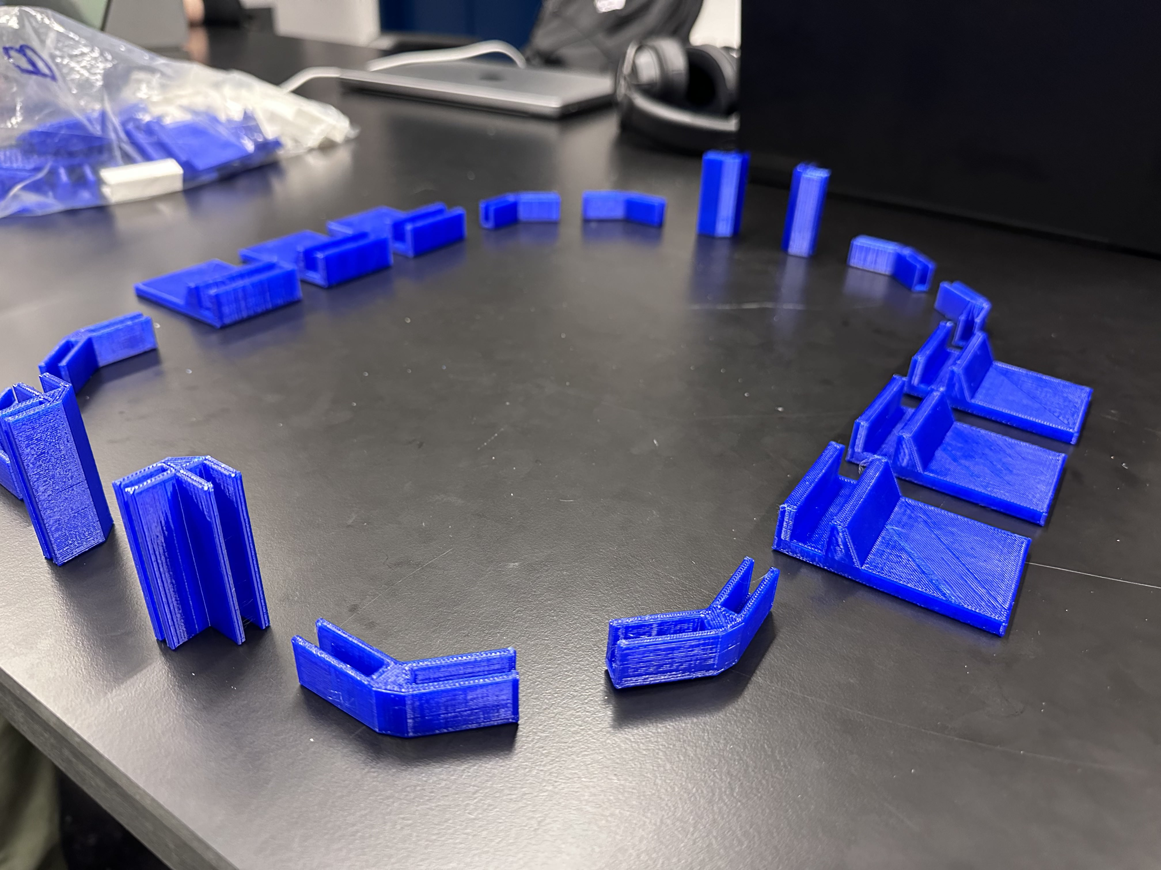
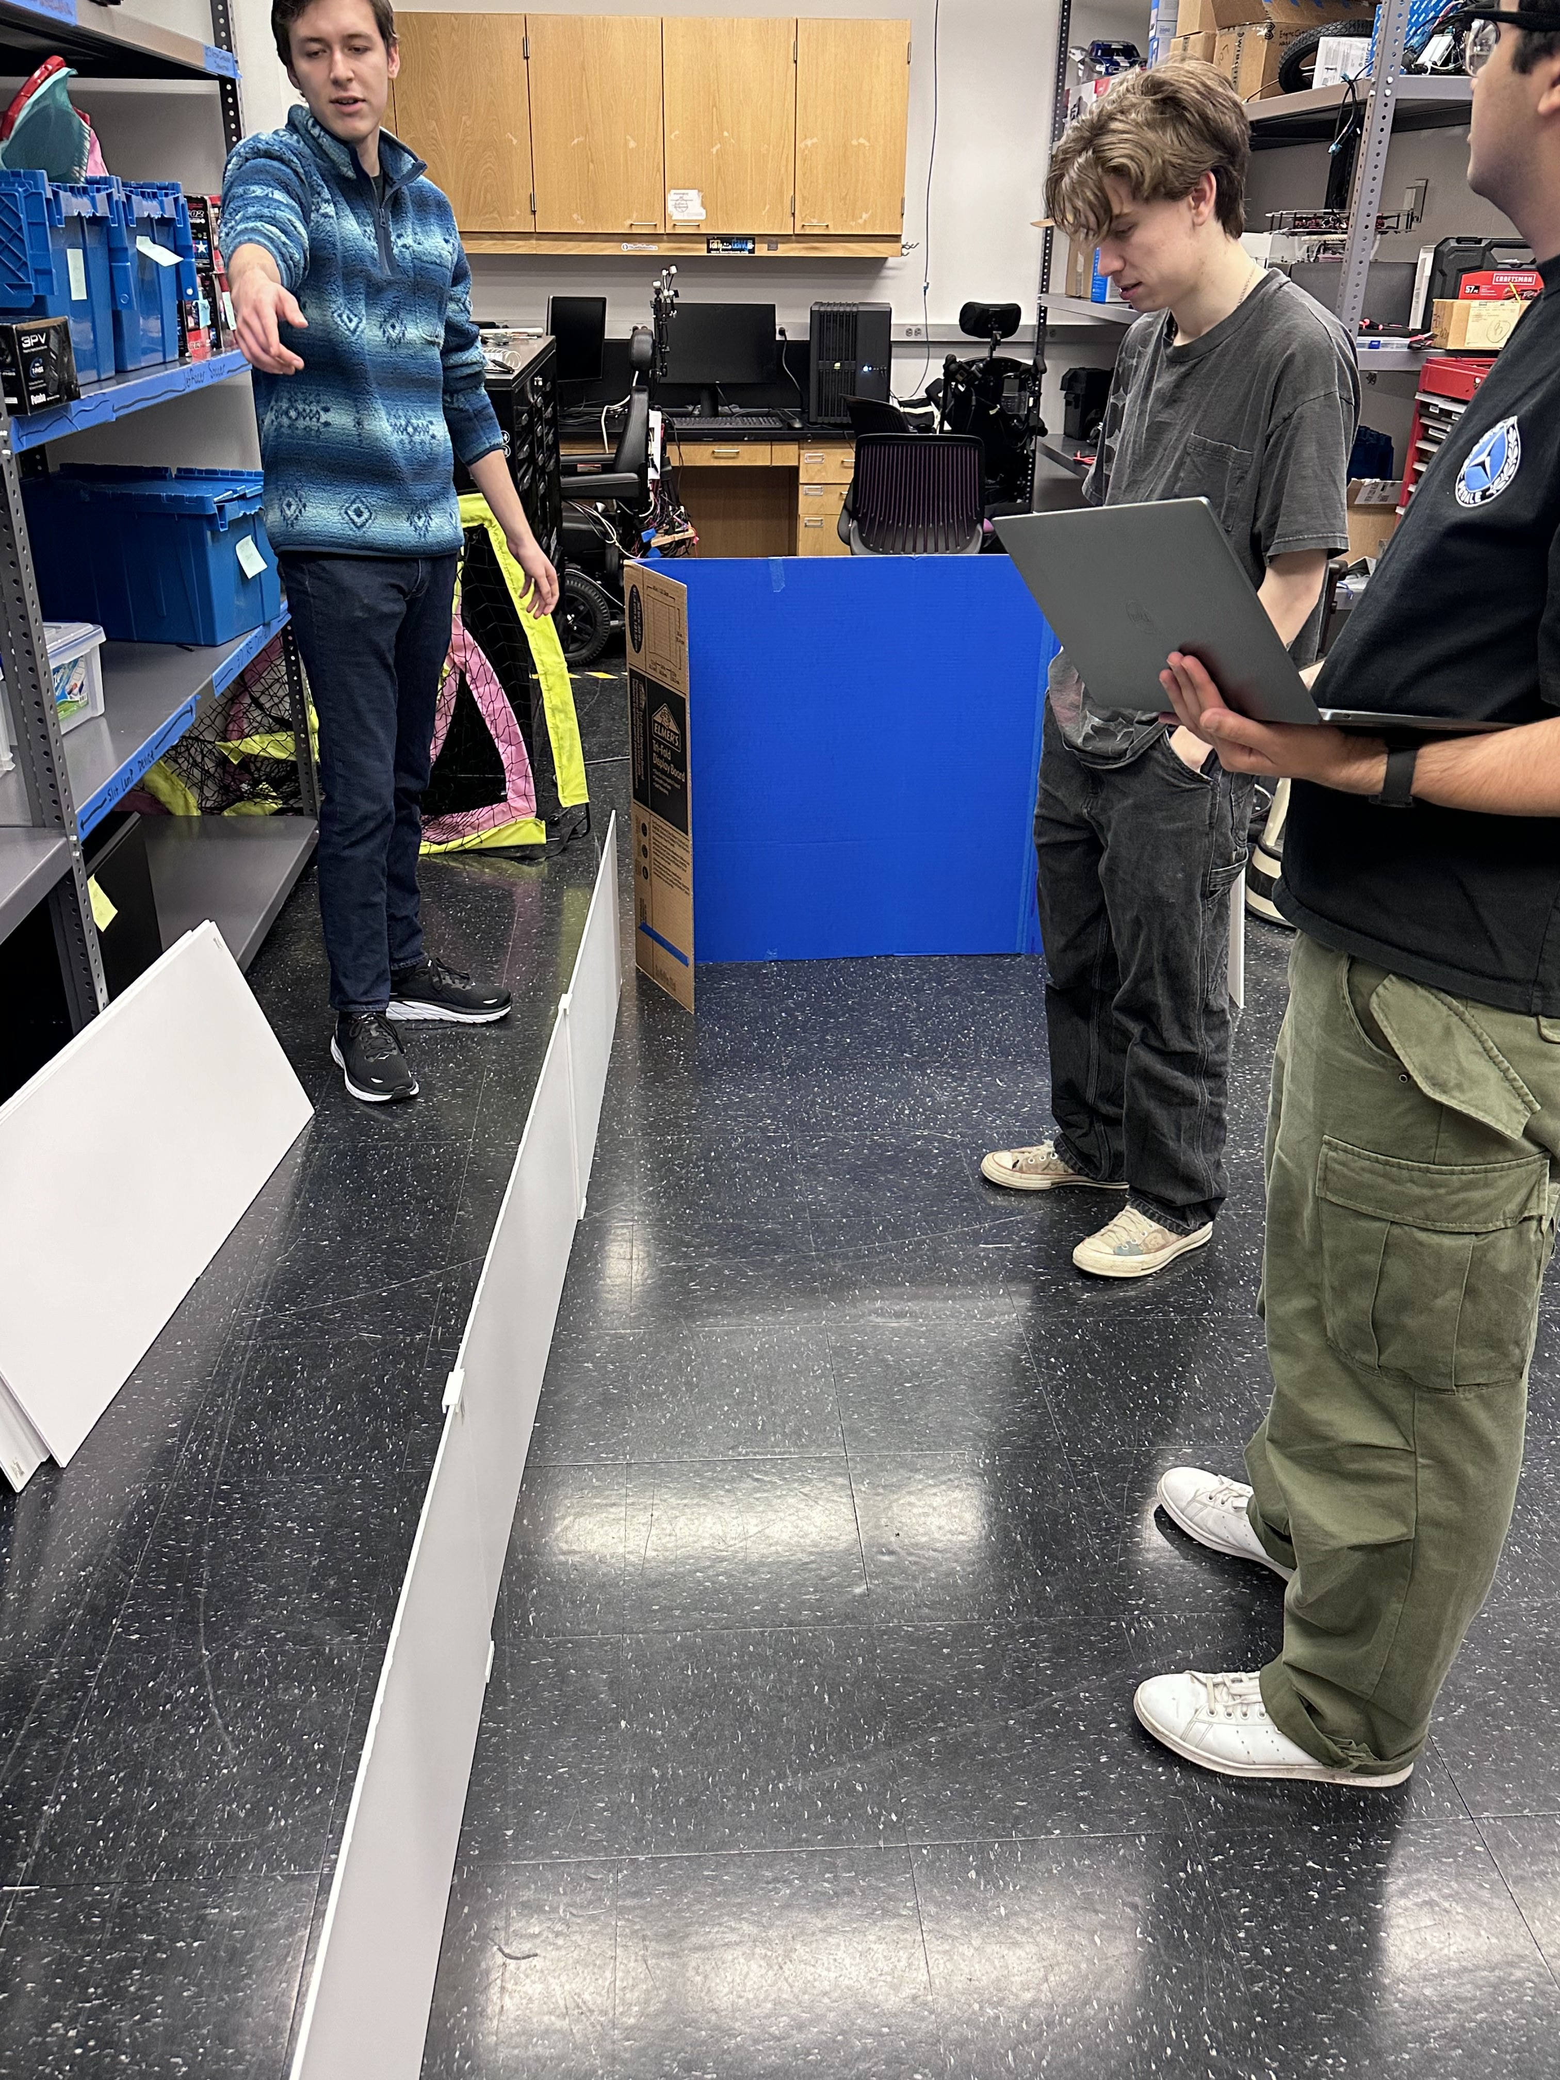
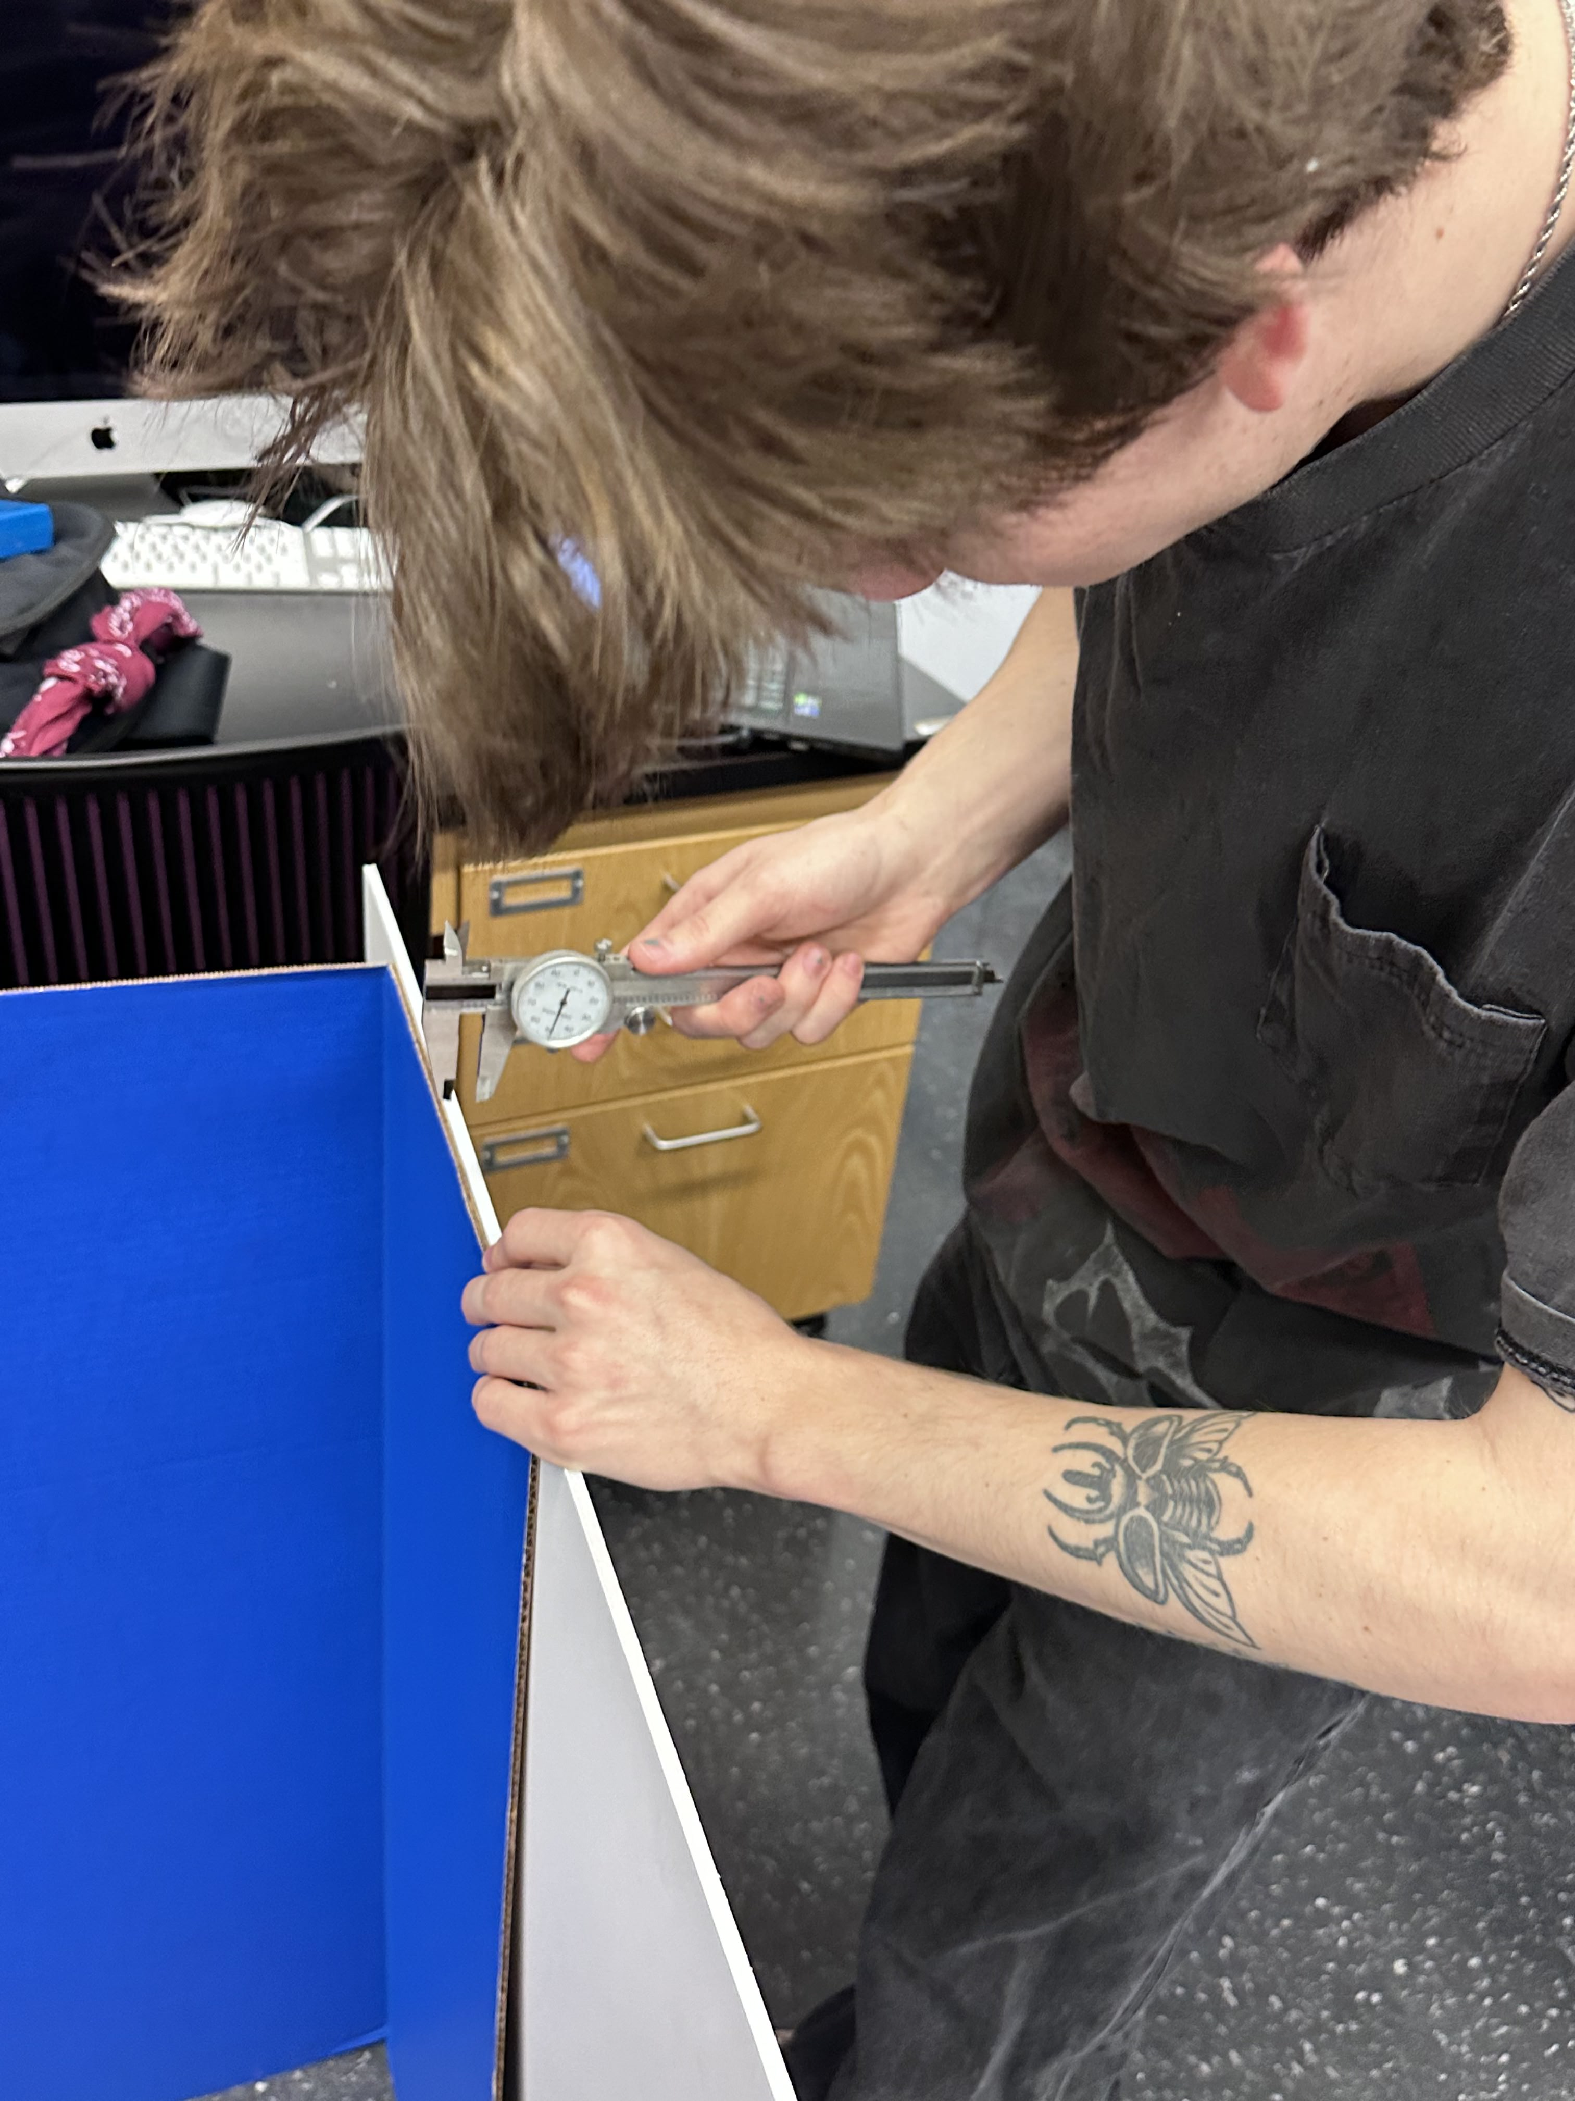
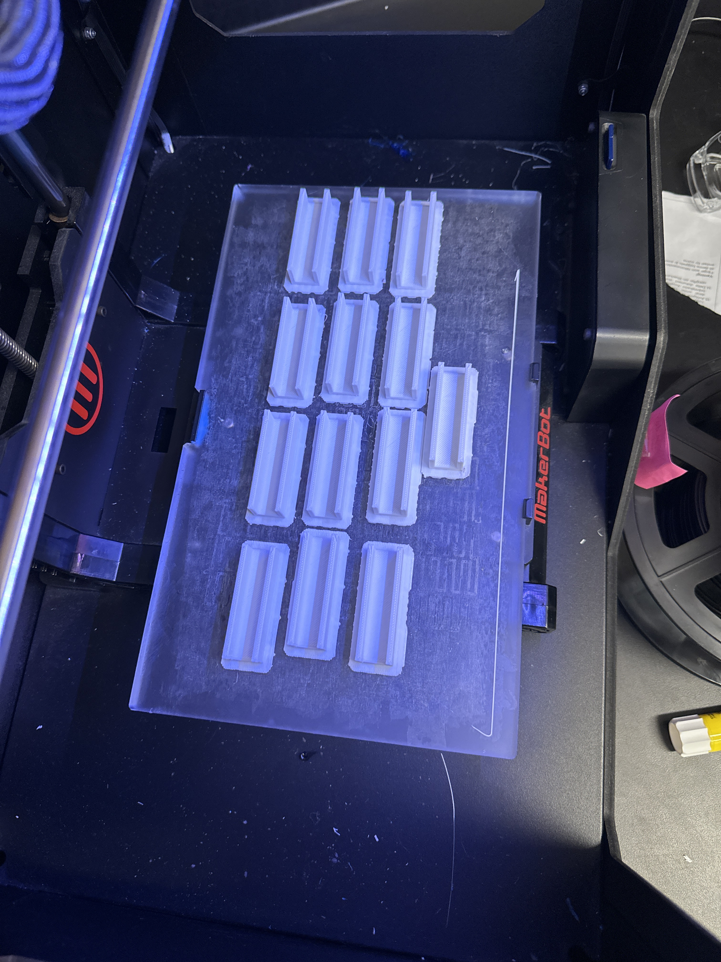
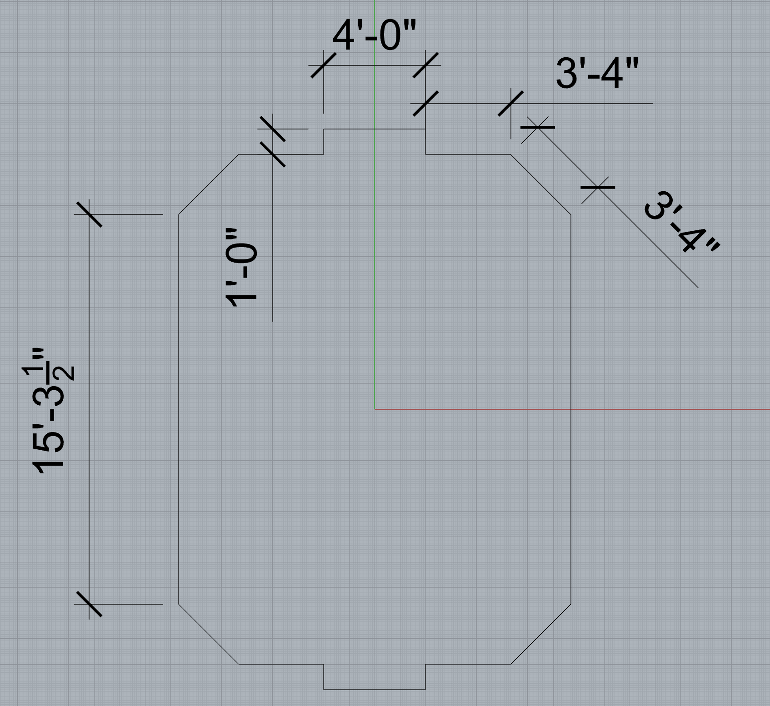

Slide 7
Computer Vision (K and Julie)
JetRacer Soccer Jarod Marshel, Casey Rittenhouse, Arjun Simha, Mason Kang, K Gupta, Julie Ham, Cooper Ritter
Previous Work:
Encountered some setbacks:
SD card from Jetson went missing
Reflashed with Ubuntu 20.04
Downloading CV packages on that new version bricked it, but we found the old SD card
Got bounding box offset to be printed to terminal
Working with ROS team to set up publisher/subscriber for the topic
Use it to steer car
Future Work:
Work with ROS team to set up publisher and subscriber for steering servo
Test steering towards ball position
Test ball following (with throttle)
Might need to update detection once ZED2 arrives

Slide 8
Unity (Mason)
JetRacer Soccer Jarod Marshel, Casey Rittenhouse, Arjun Simha, Mason Kang, K Gupta, Julie Ham, Cooper Ritter
Previous Work:
Optimized the simulation further, start looking to the movement parameter of the machine learning agents, the goal is to simulate the cars movement IRL as realistic as possible.
Future Work:
Create a 3rd year repo for the JetRacer github page for the sake of progress tracking.
Improve the machine learning agent model so that they have a realistic collision model.
Continue to improve the movement of the simulated cars and the integration of the environment using the SDK.
May shift focus to other aspects of the project

Slide 9
Tradeoff Study
Sensor Choice

Slide 10
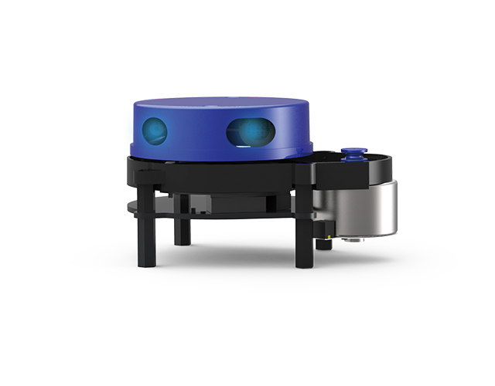
2D Lidar
Benefits:
Provides map of field
Limited position data for car
Able to share car position data with teammate/opponents
Limitations:
Space inefficient/ difficult to mount
Does not provide ball information
Tracking ball requires car to turn

Slide 11
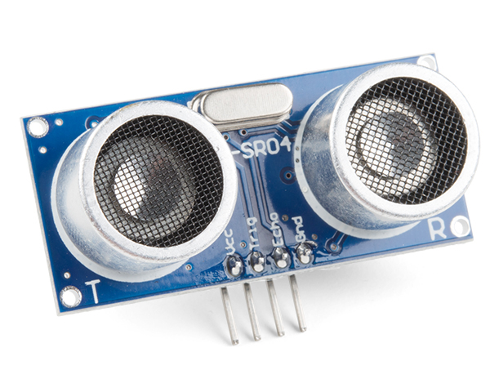
Ultrasonic
Benefits:
Able to track ball and provide distance to ball
More space efficient
Cost effective (compared tgo LiDar
Short lead time
Conical detection gives more margin for error
Larger FOV
Can see transparent objects
Limitations:
Short range
Limited accuracy
Noisy signal
Lower sensing accuracy than LiDAR
Can't sense soft materials (fabric)

Slide 12
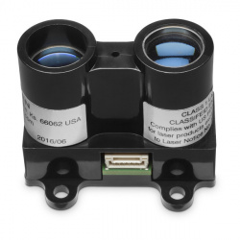
1D LiDAR
Benefits:
More accurate and less noisy than ultrasonic
Can detect smaller objects
Larger detection range
Fast polling/detection rate
Limitations:
Narrower FOV than ultrasonic
Can be costly ($50-$100)
Can't see transparent objects

Slide 13
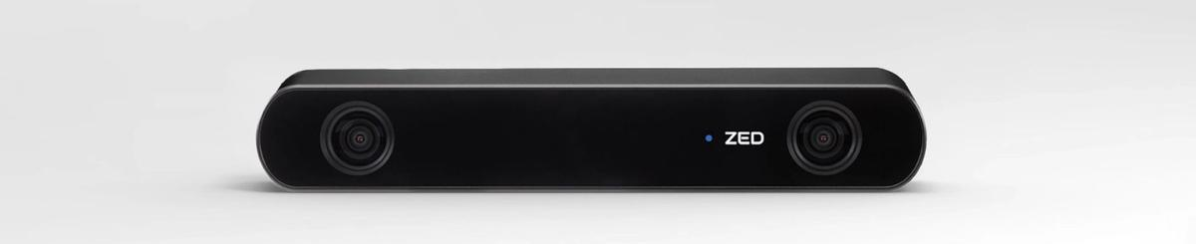
ZED 2
Benefits:
Onboard processor for sensor fusion (reduces computation overhead)
Stereo camera for better depth perception
Wide FOV (110°(H) x 70°(V) x 120°(D))
Replicates functionality of LiDAR + more (color + depth)
Easily integrates with ROS
Built-in SDKs for a variety of applications, including object tracking
Large detection range (up to 40m)
Able to test without purchase
Limitations:
Cost ($450 each)
Size (6.90 x 1.19 x 1.69")
Weight (0.5 lbs)
Lack of traditional hardware distance sensing

Slide 14
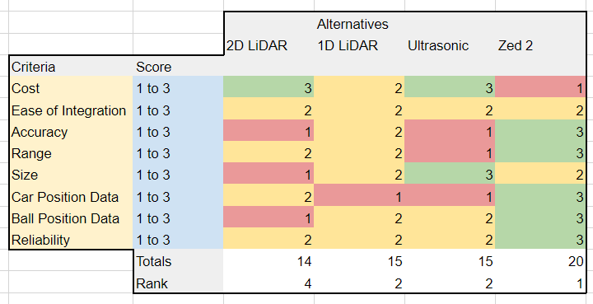
Pugh Matrix

Slide 15
Recommendation
We have access to a ZED 2 camera that we can use for preliminary testing
After verifying that it meets our needs and that we can integrate it properly, we should order 4 cameras
Won't waste too much time – can easily pivot to 1D LiDAR or ultrasonic
Would still use servo for mounting (see following slide)

Slide 16
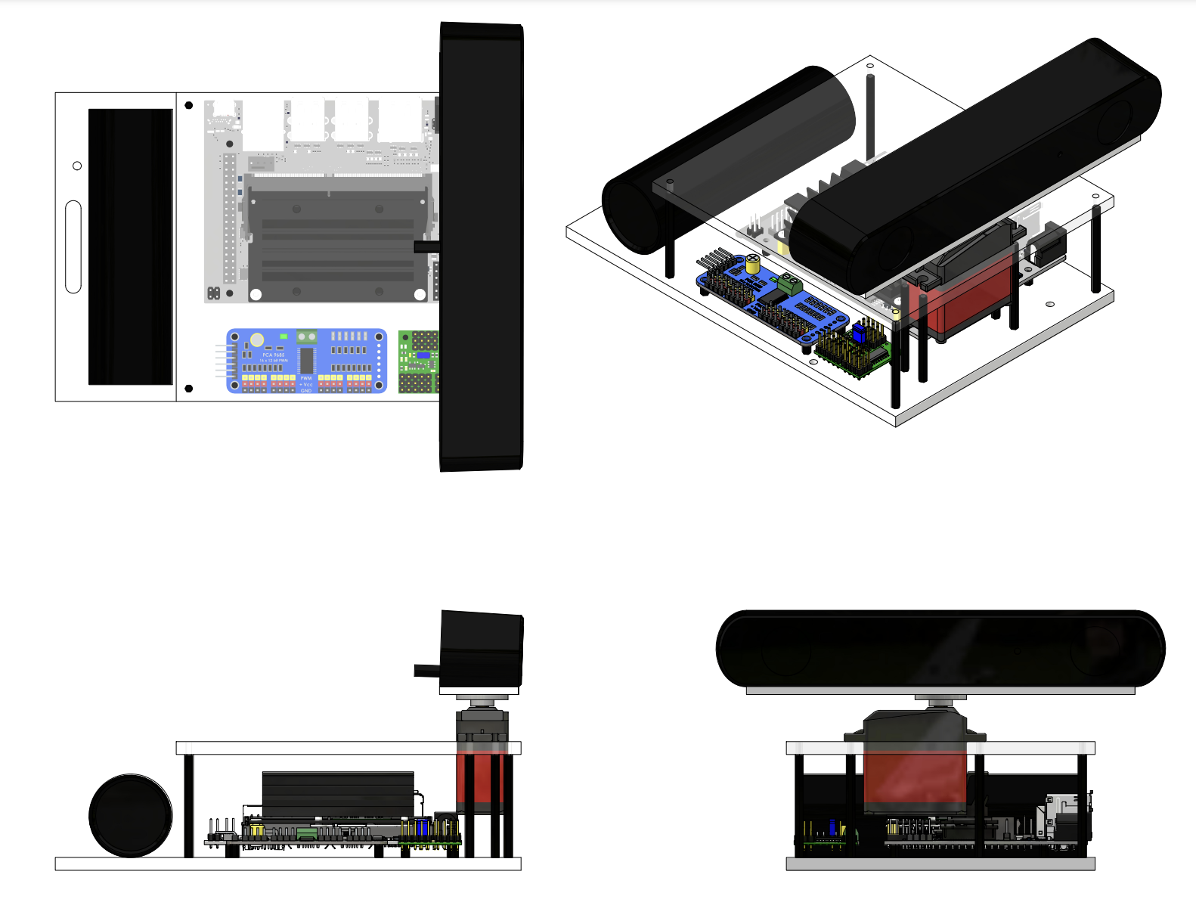

Slide 17
Questions:
Project scope
What level of co-op soccer are we looking for?
Might be hard to get true soccer strategy
Unity integration onto cars
Realistic constraints
Pipeline to port models onto cars
Zed camera
What additional capabilities does this unlock?
What capabilities do we lose?
Servo mount

Slide 18
Team Roles
Project Manager - Jarod
Point of Contact - Arjun
Budget Manager - Casey
ROS/Hardware (Layout, PCB, CAD, LiDAR):
Cooper, Casey, Jarod, Arjun
Unity Team:
Mason
CV/Image Recognition Team:
K, Julie

Slide 19
Previous Year's Work
Built and gained full range of motion of 4 JetRacers using software
Set up a simulation environment to virtually train the agents
Structured a reward system for the reinforcement learning model
Implemented object detection model that identifies a soccer ball, opponent, and goal
Implemented software to follow and strike a ball
Developed logic process for striking a ball into a goal
Simulation results with reward structure demonstrate that agents can be trained to efficiently compete in a 2v2 soccer match
Created a GitHub page documenting the hardware and software instructions to setup JetRacers, a summary of the work completed, and plans for future work

Slide 20
Our Final Deliverables
Demonstrate basic motion of JetRacer: 01/2024
Demonstrate JetRacer Image Recognition for soccer play: 01/2024
Trade study of possible sensor additions: 02/2024
Preliminary Design Review: 02/2024
Showcase vehicle scoring soccer ball in the goal in real-world: 03/2024
Add additional agents in the real world: 04/2024
Final Data Review: 05/2024

